Slide 1
X-section GBN-GBS – Gamkaberg Nature Reserve
See Cross section locations.kmz & Cross section labels.kmz for location in Google Earth

Slide 2
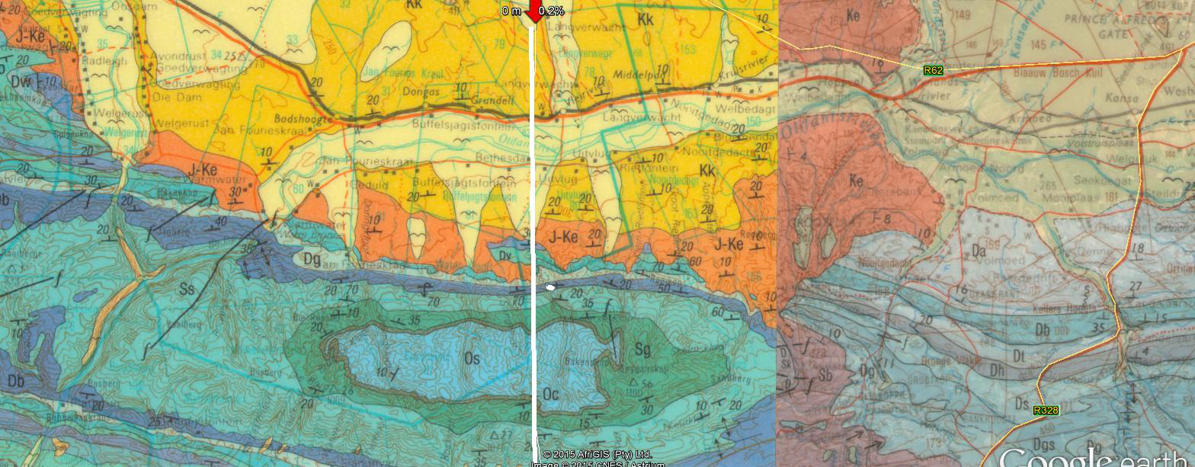

Schematic Geologic Cross Section GBN-GBS – Gamkaberg Nature Reserve
GBN
1:250 000 3320 LADISMITH
1:250 000 3322 OUDTSHOORN
Gamkaberg Camp
Gamkaberg Nature Reserve
GBS
masl
masl
1000
Bakenskop
1000
Cretaceous Oudtshoorn (half) graben
Ss
Sg
Oliefants River
Os
500
R62
Oc
500
Kk
0
J-Ke
0
Da
Kaaimans and/or
Kango
Dbo
Dw
Ss
Dt
Dga
Dg
Db
Sg
Os
Cape Granite
-500
Dh
Oc
-500
Dv
Dga
0
5
10
15
km
GBN
Cross section GBN-GBS Gamkaberg Nature Reserve.pptx https://ferdivberkel.github.io
GBS

